Slide 1
Market Place
20155205 고정환
20155348 한지용
20165334 정주영
20185209 권혁빈

Slide 2
Index
Plug-In
Market Place
Examples

Slide 3
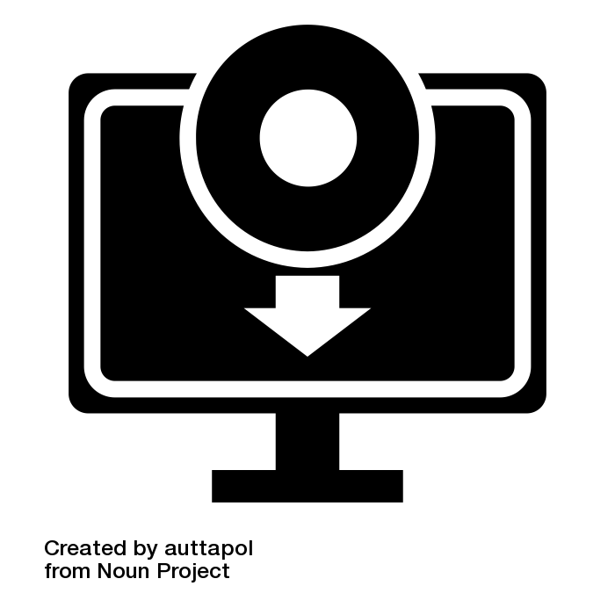

PLUG IN

Slide 4
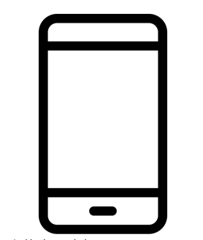




SMARTPHONE-APPLICATION

Slide 5
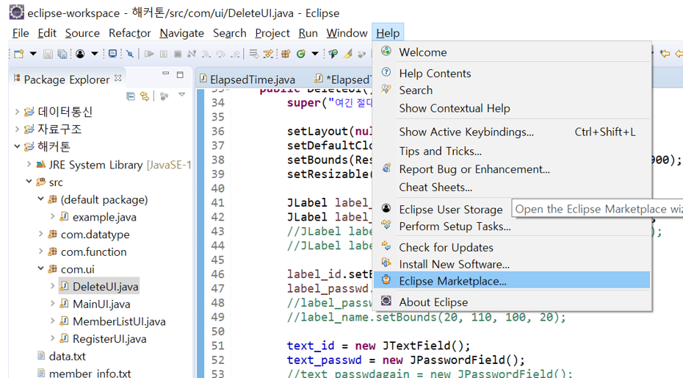
MARKETPLACE

Slide 6
EXAMPLES
Darkest Dark Theme
Window Builder
PyDev-Python IDE for Eclipse
Egit-Git Integration for Eclipse

Slide 7
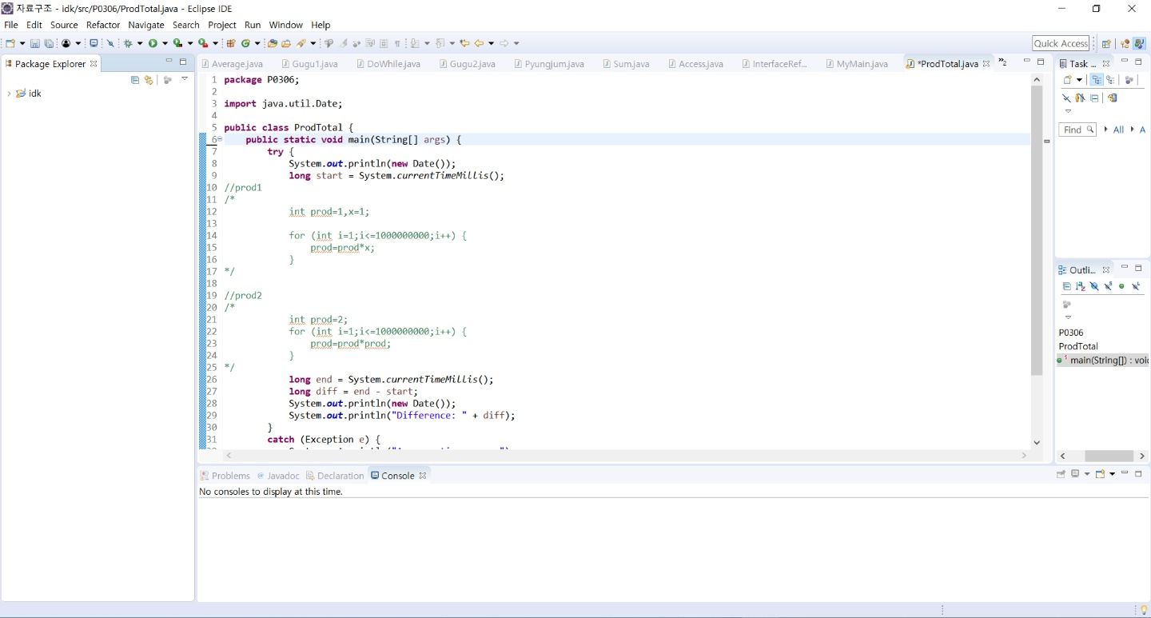
Darkest Dark Theme

Slide 8
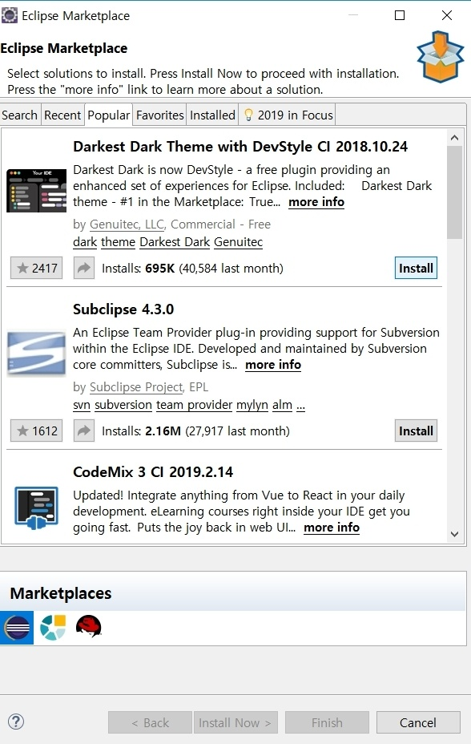
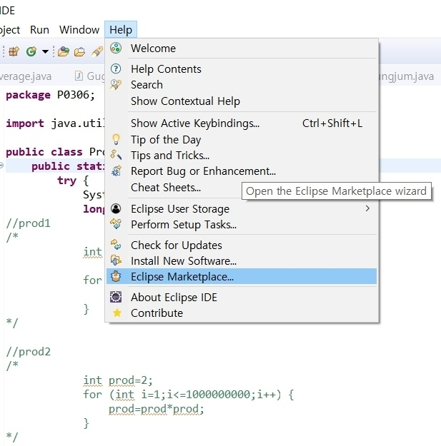
Darkest Dark Theme

Slide 9
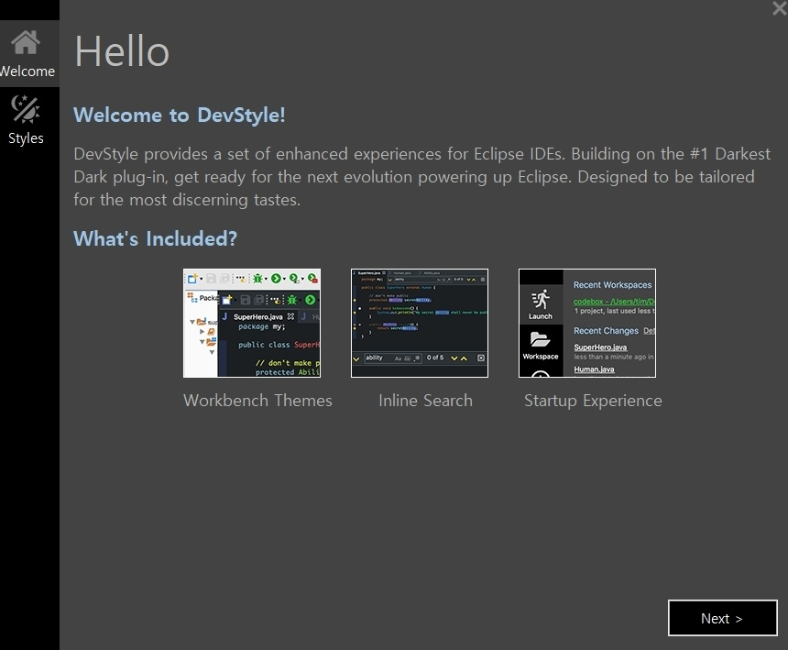
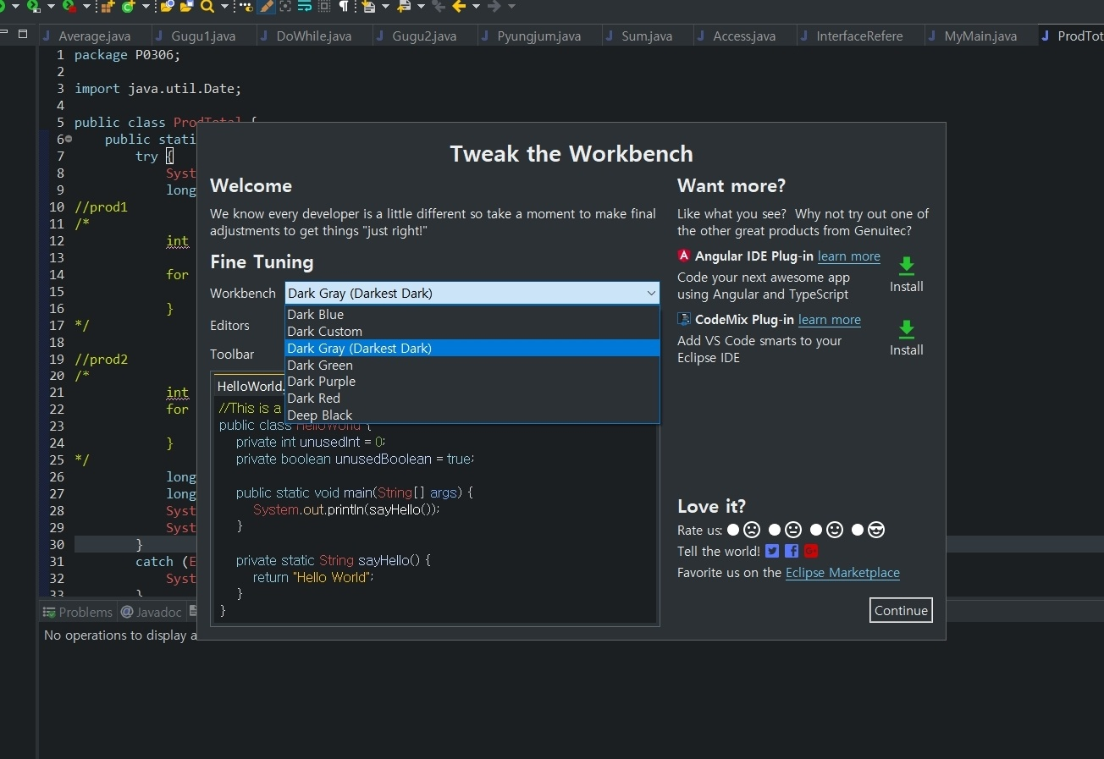
Darkest Dark Theme

Slide 10
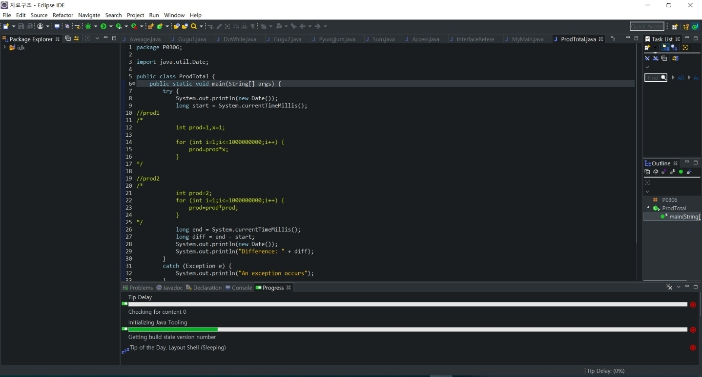
Darkest Dark Theme

Slide 11
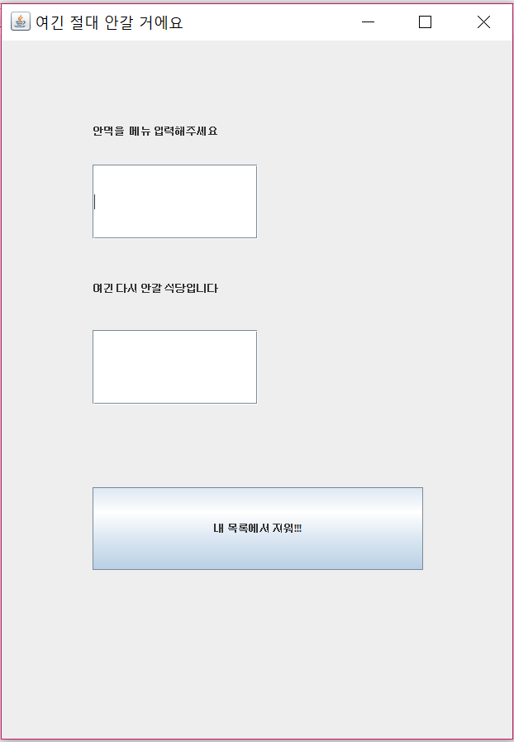
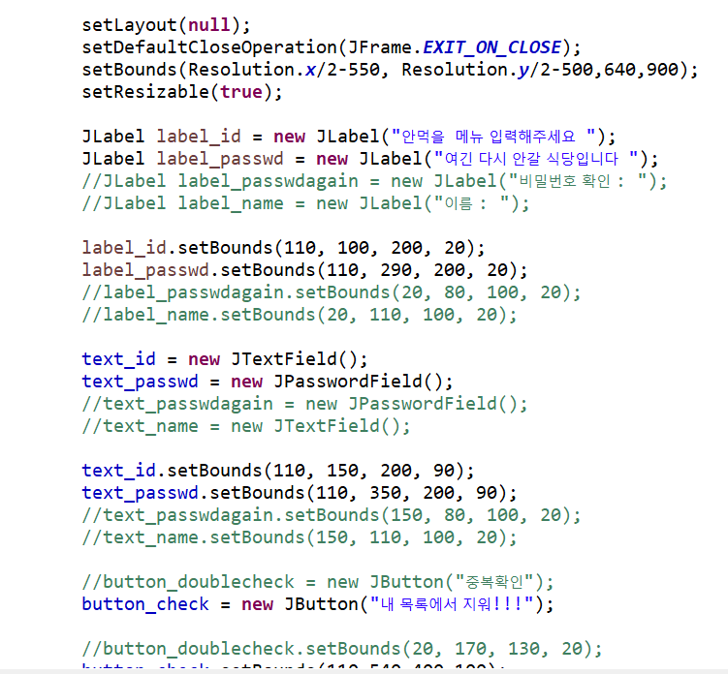
Window Builder

Slide 12
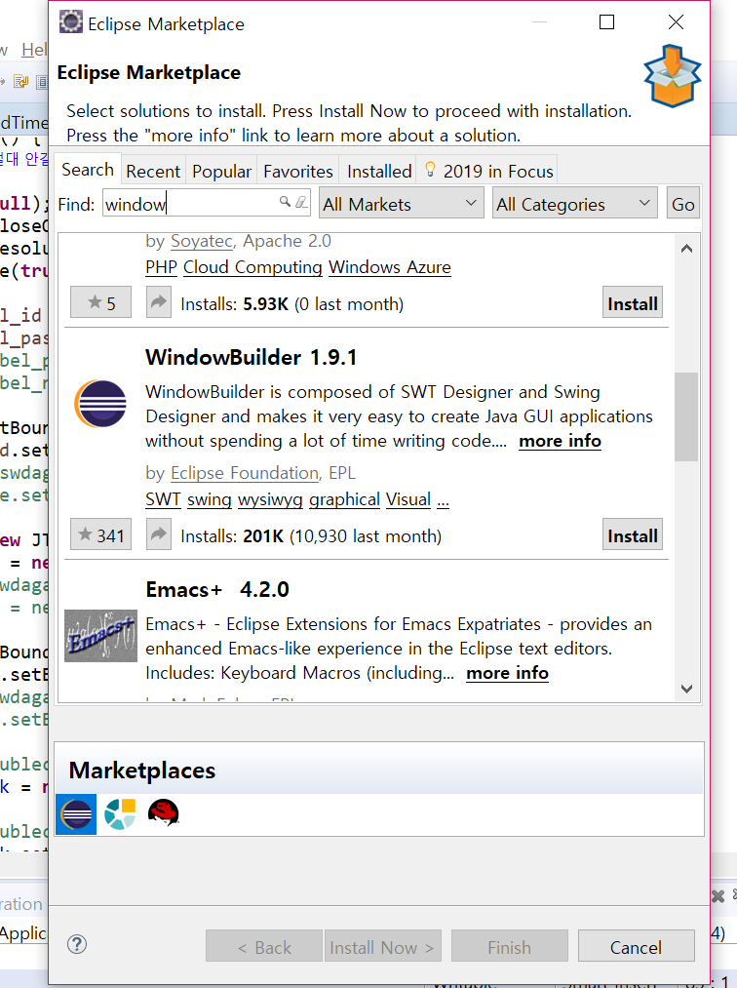
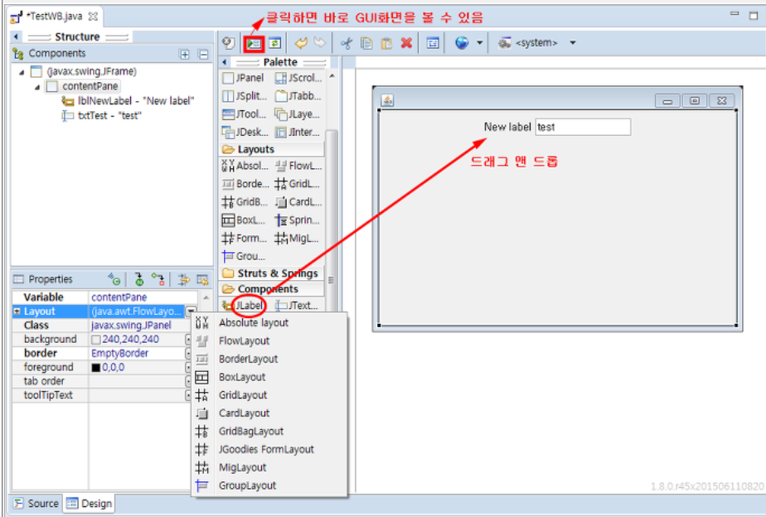
Window Builder

Slide 13
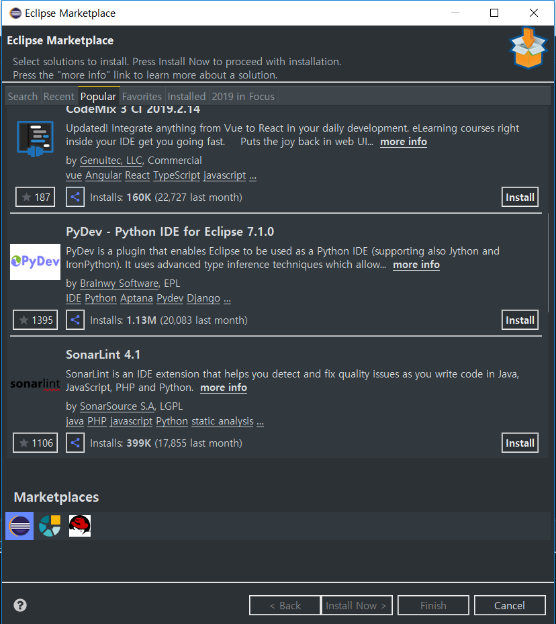
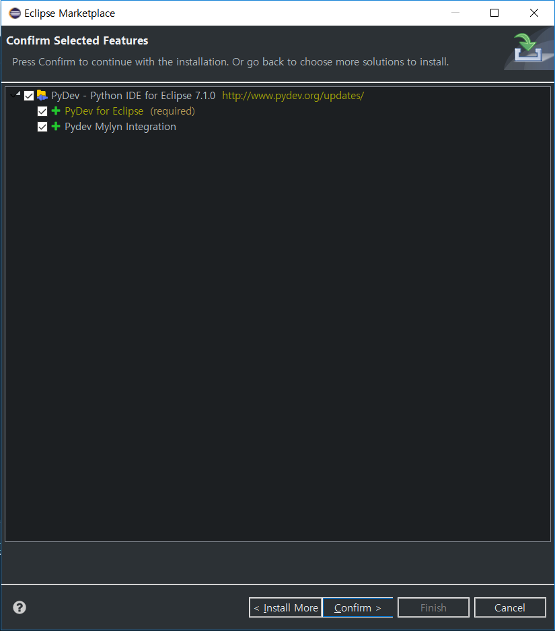
PyDev-Python IDE for Eclipse

Slide 14
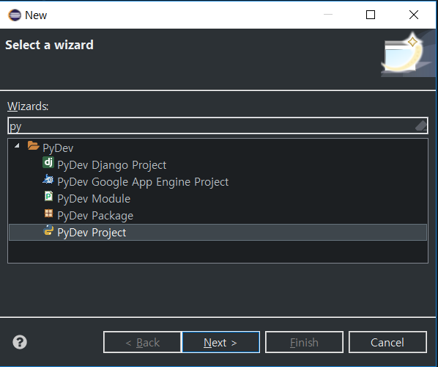
PyDev-Python IDE for Eclipse

Slide 15
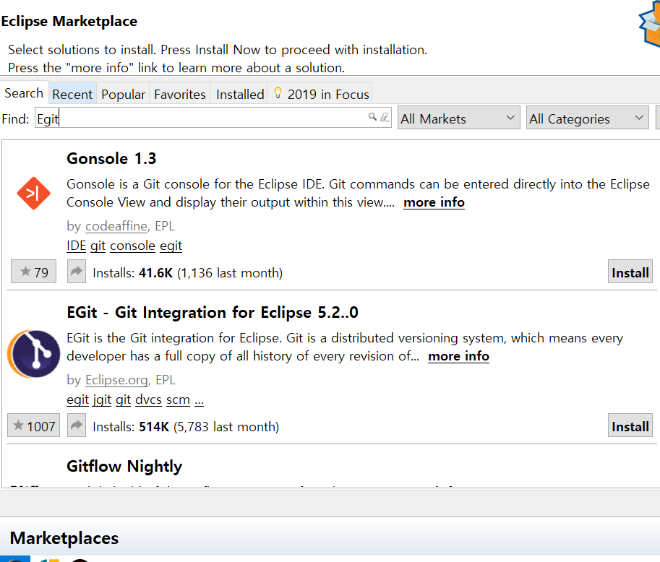
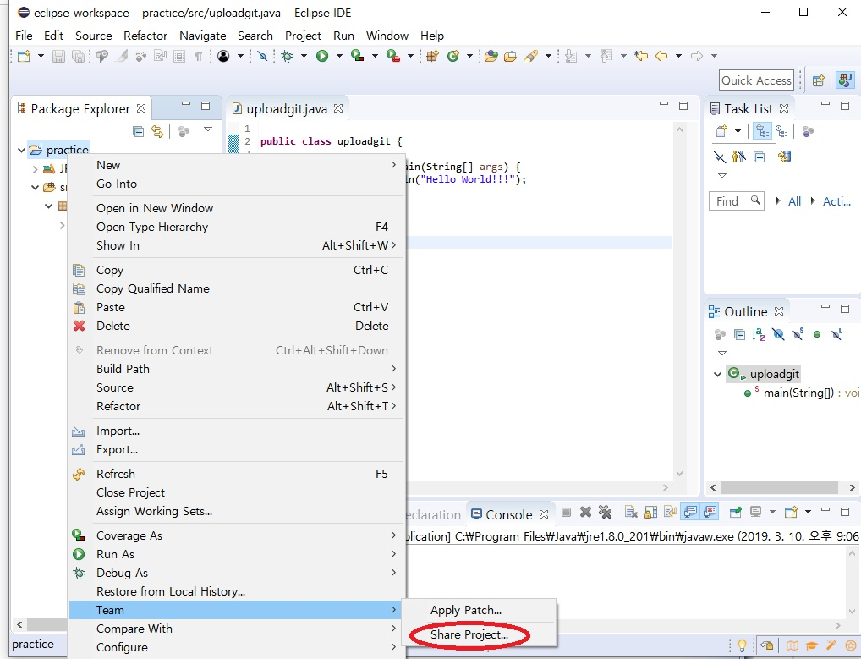
Egit-Git Integration for Eclipse

Slide 16
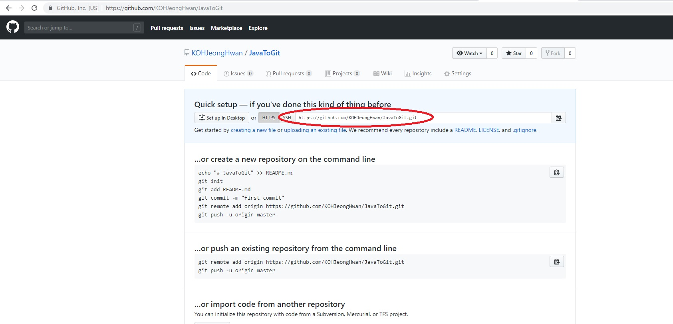
Egit-Git Integration for Eclipse

Slide 17
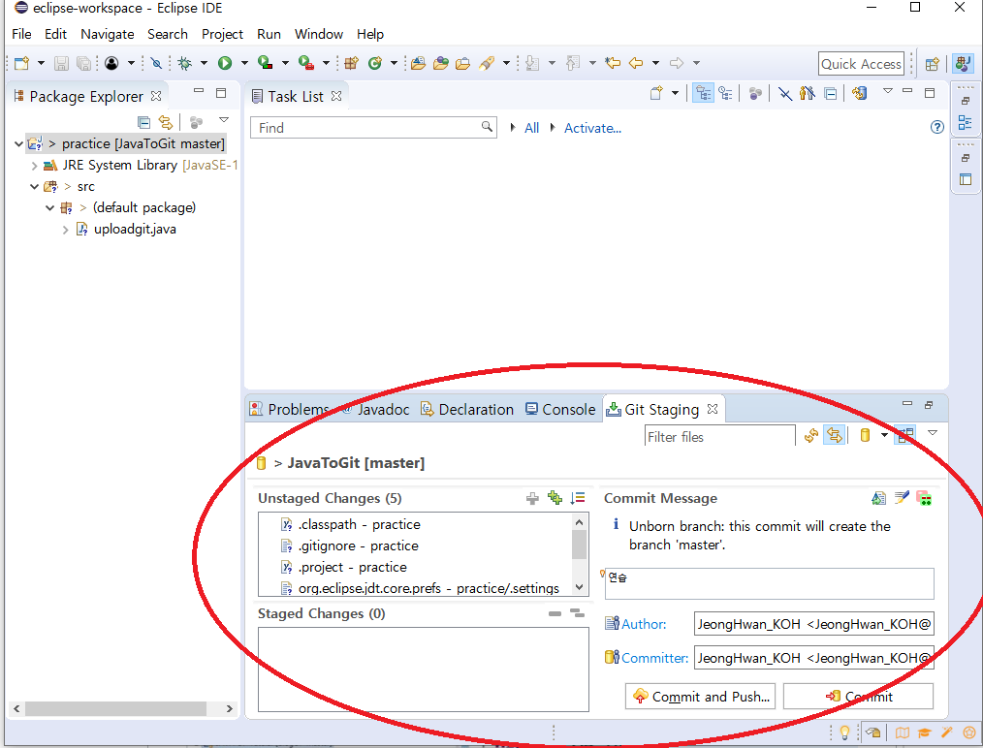
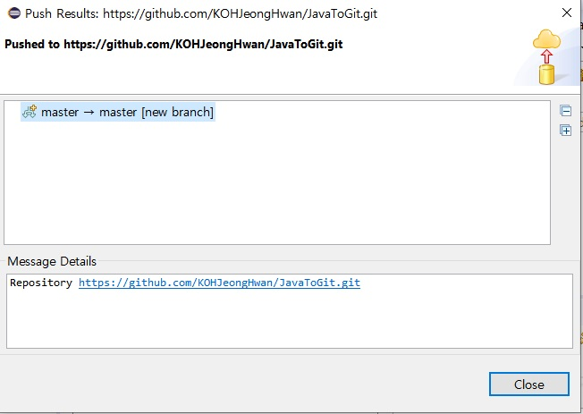
Egit-Git Integration for Eclipse

Slide 18
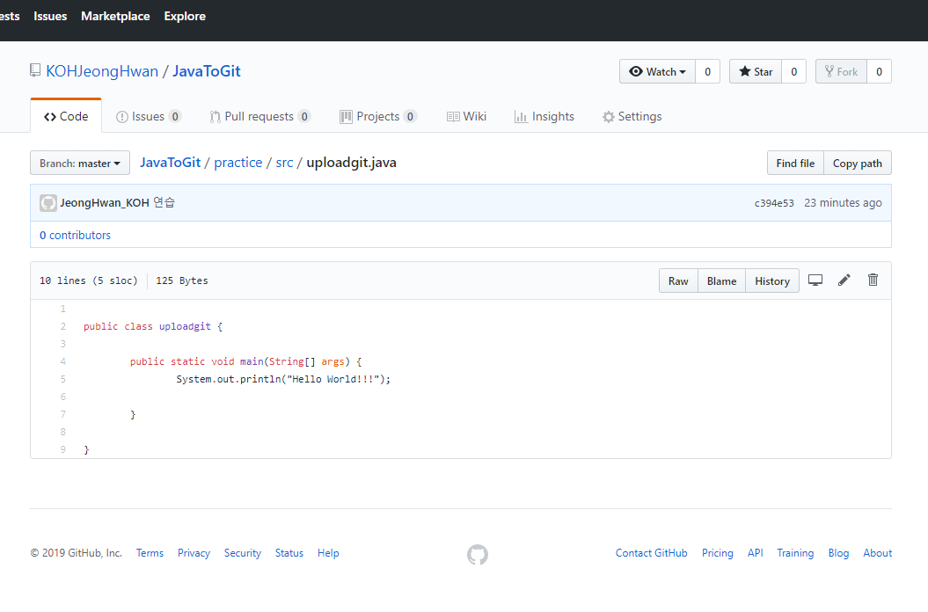
Egit-Git Integration for Eclipse

Slide 19
Thank you

